Slide 1
RESTAURANT ANALYSIS
ZOMATO
BY: YASH GUPTA

Slide 2
CONTENTS
Problem Statement
Data Overview & Data Cleaning
Introduction
Suggested Countries
Cities in Suggested Countries
Improve Performance in Low-Rating Areas
Lesser Competition & Average Rating in the Suggested Countries
Annual Restaurants Opening Overview
Average Voting in the suggested Countries
Total Expenditure on Foods
Choice of Cuisines
Mode of Bookings
Summarized Conclusion
Dashboard
Features included in DASHBOARD

Slide 3
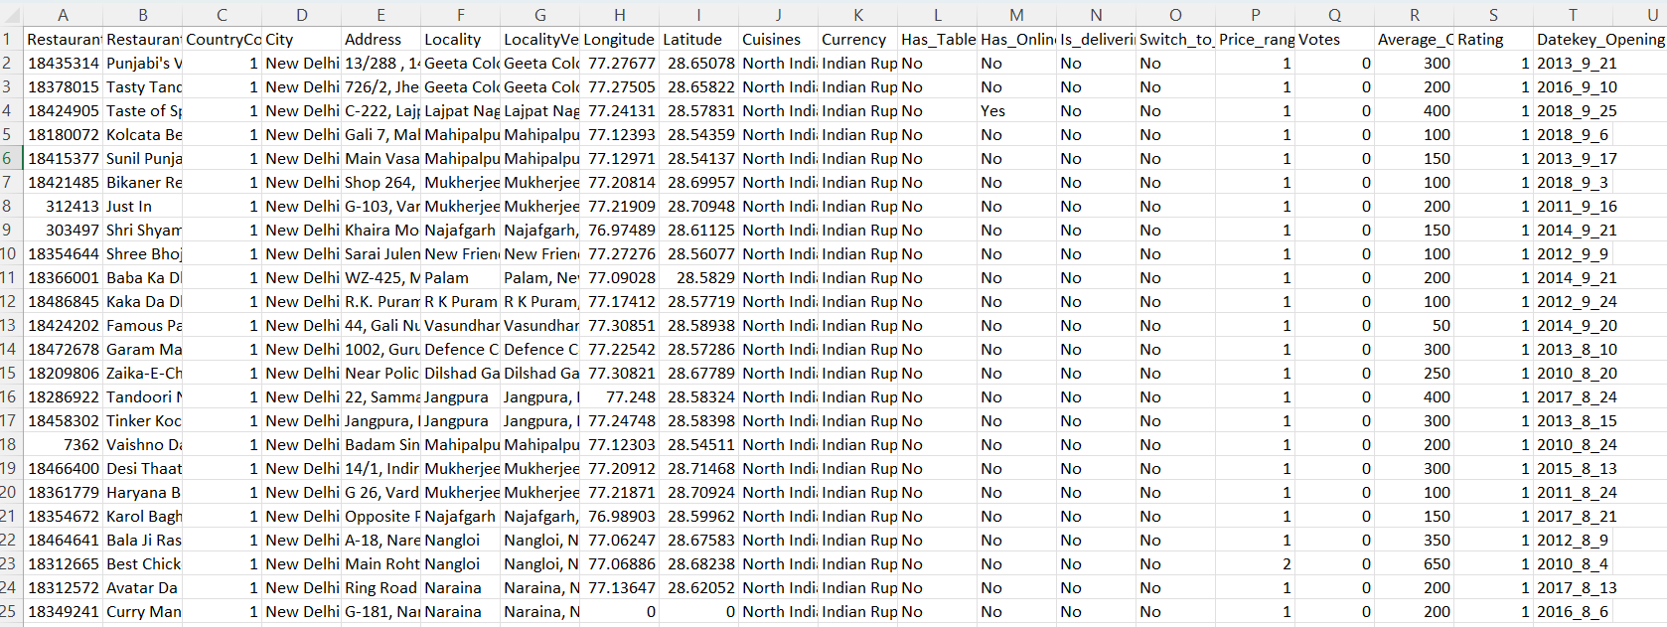
PROBLEM STATEMENT
You are hired as a consultant data analyst by Zomato where the team is looking for expansion and opening restaurants. Your task is to come up with strategies/suggestions for opening newer restaurants.

Slide 4
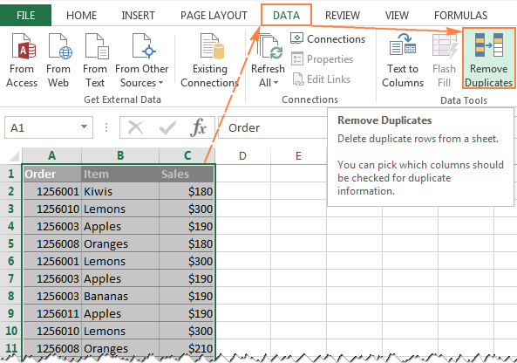
DATA OVERVIEW & DATA CLEANING
Data Overview
There is a total of 9551 restaurants worldwide.
Most of the restaurants were opened in the year 2018.
We can see that most restaurants have online deliveries and table bookings.
Restaurants have a price range between 1- 4.
Different restaurants have different ratings based on their cities’ cuisines and price range.
Data Cleaning
There are null values present in columns Longitude, Latitude and votes are replaced by their average respectively.
There are 9 blank cells found in the column cuisines are replaced by cuisines based on their country codes.
All currencies are updated in the Indian Rupees in the new column created named currency Updated.
Year is extracted from the column Datekey_ Opening.
Data is well maintained with the help of wrap text, borders and Bold functions.

Slide 5
INTRODUCTION
My extensive analysis, which I conducted as a consultant data analyst for Zomato, shows several essential strategic requirements for opening new restaurants. Market Segmentation According To User Preferences And Demographic Trends Provides A Sophisticated Way To Customize Restaurant Services To Particular Customer Segments, Maximizing Success Across Various Locations. Utilising location information makes it possible to identify places with strong demand and minimal competition, making it easier to choose great locations to optimise foot traffic and visibility. Developing Menus And Making Operational Enhancements To Improve The Whole Eating Experience Is Made Possible Through Insightful Analysis Of Zomato Customer Feedback And Cuisine Trends. Lastly, A Thorough Plan For Profitable Restaurant Expansion Includes Considerations For Sustainable Practices And A Varied Menu To Meet Changing Customer Tastes.

Slide 6




SUGGESTED COUNTRIES
Australia
Sri Lanka
Canada
Singapore

Slide 7
CITIES IN SUGGESTED COUNTRIES
Australia
Singapore
Armidale
Balingup
Macedon
Penola
Flaxton
The cities with the lowest ratings are the most suitable for the opening of new restaurants.
Singapore
Canada
Sri Lanka
Consort
Yorkton
Colombo

Slide 8

IMPROVE PERFORMANCE IN LOW-RATING AREAS
Recommendation:
Identify and address the issues in regions with lower average ratings.
Data-Driven Reason:
Analysis of low-rated restaurants can reveal common pitfalls such as poor service, food quality, or ambience, which need to be rectiﬁed
Expected Impact:
Enhanced Customer Satisfaction: By addressing these issues, Zomato can improve overall customer experience, leading to better rating reviews.
Strengthened Market Position: Elevating performance in low-rated areas can reduce the risk of losing customers to competitors and improve Zomato's reputation in these regions.

Slide 9
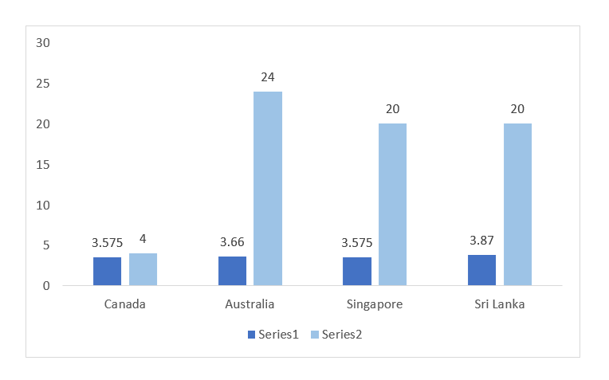
LESSER COMPETITION & RATINGS IN THE SUGGESTED COUNTRIES
Less Number Of Restaurants Opened
Countries with fewer restaurants face less competition compared to those with a higher number of restaurants.
Analysis shows that Australia, Canada, Sri Lanka and Singapore have relatively fewer restaurants.
Average Rating in the countries
The average restaurant rating in the suggested countries ranged between 3.5 to 4.5
This range suggested that the restaurants had moderate to moderately unfavourable ratings.
Overall the ratings indicate a mixed experience with quality that varies from satisfactory to slightly below expectations.

Slide 10
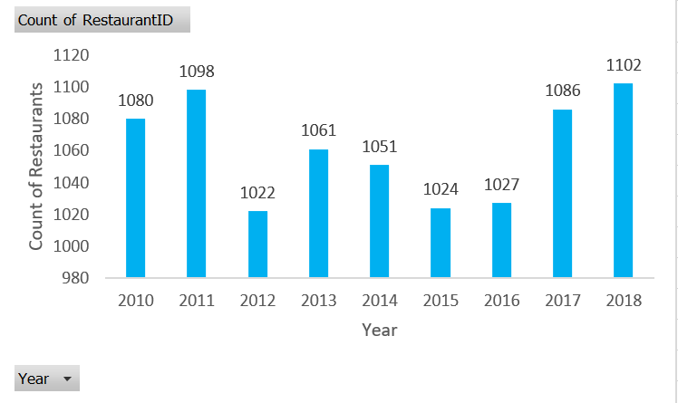
ANNUAL RESTAURANTS OPENING OVERVIEW
The Data Shows Stable Growth In The Restaurant Industry, With Occasional Fluctuations Due To Economic Factors
Analyzing The Data, We Can Observe The Trends In Restaurants Opening Across Different Years.
2010: Increased to 1,080 new openings, showing growth.
2011: Rose to 1,098 openings, continuing upward trend.
2012: Slight dip to 1,022 due to possible market saturation
or economic factors.
2013: Rebounded to 1,061 openings, indicating renewed growth.
2014: Minor decline to 1,051, maintaining steady progress.
2015: Stable at 1,024 new openings, reflecting consistent demand.
2016: Slightly up to 1,027, showing industry resilience.
2017: Increased to 1,086, driven by renewed consumer interest.
2018: Peaked at 1,102 openings, the highest in the period, signalling strong market growth.

Slide 11
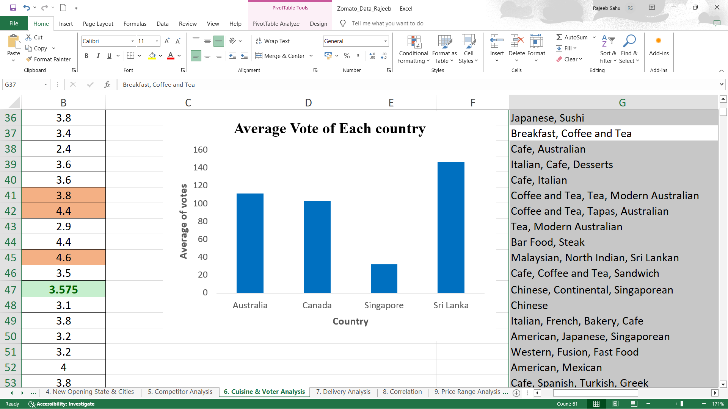
AVERAGE VOTING IN THE SUGGESTED COUNTRIES
Based On The Provided Voting Data,
Sri Lanka: Highest average voting score of 146, reflecting strong voter engagement.
Australia: Average score of 111, indicating moderate interest.
Canada: Score of 103, showing slightly lower engagement.
Singapore: Lowest average score of 32, suggesting reduced voter participation.
Overall, the Data Suggests Varied Levels Of Voter Engagement Across These Countries.

Slide 12

TOTAL EXPENDITURE ON FOODS
The pie chart illustrates the total expenditure on food across four suggested countries: Sri Lanka, Australia, Singapore, and Canada.
Singapore- ₹ 1,91,573
Australia- ₹ 31,362
Sri Lanka- ₹ 12,825
Canada- ₹ 8,922
The chart highlights a clear disparity in food expenditure, with Singapore being the largest contributor and Canada the smallest.

Slide 13
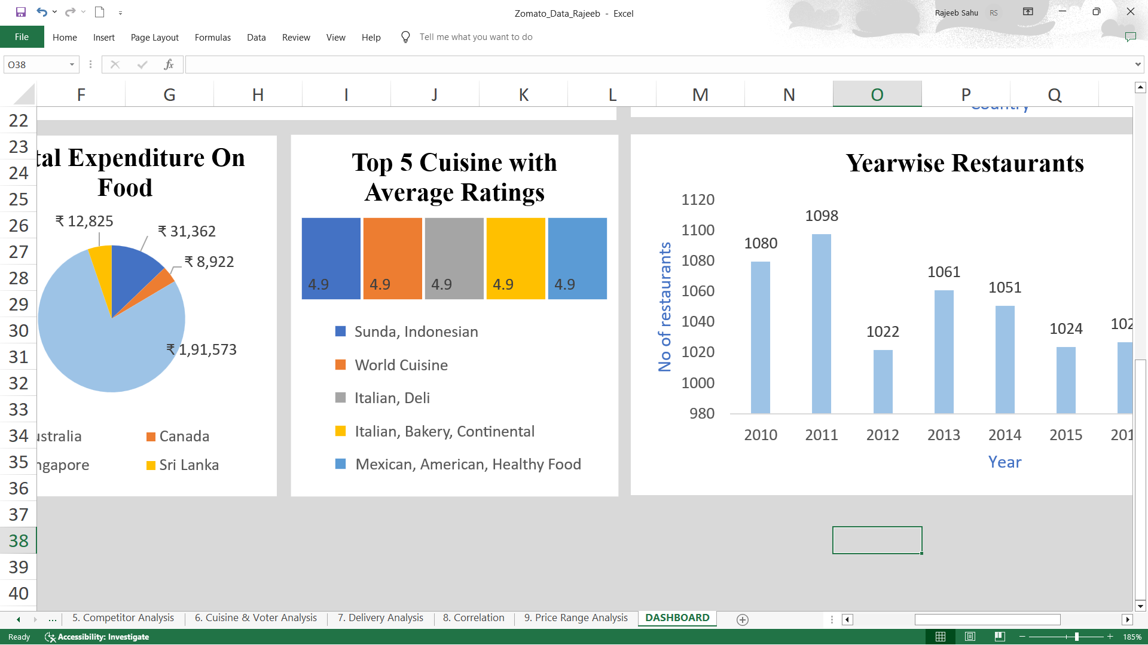
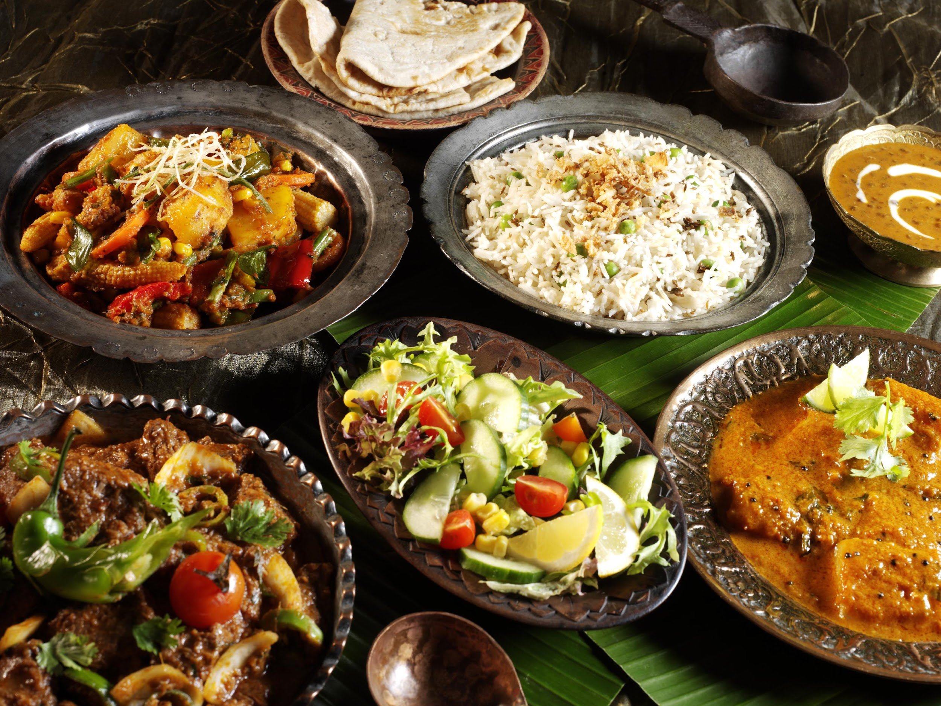

CHOICE OF CUISINES
According to my analysis, most individuals prefer their local cuisine over foreign cuisines, and restaurants that serve local cuisine and have higher ratings tend to receive better feedback. Thus, I've chosen a few regional dishes as well as a few more that received better reviews. Here are the top five cuisines in the suggested countries based on customer feedback.

Slide 14
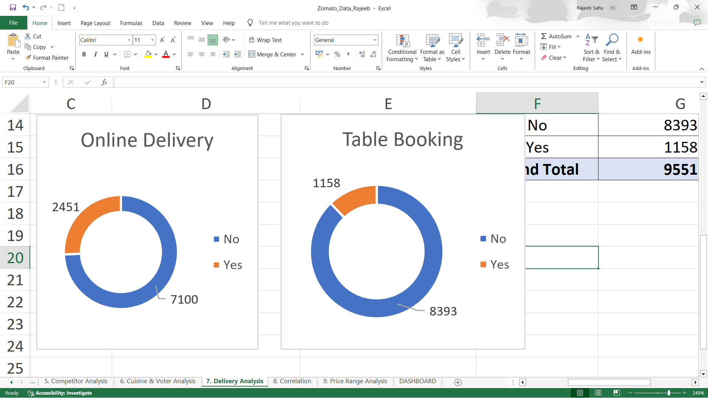


MODE OF BOOKING
Research shows no restaurants in these countries currently offer online or table booking services, presenting an opportunity for innovation.
74.34% of restaurants cater to walk-ins; 25.66% offer table bookings, likely for formal dining or high-demand areas.
87.88% of restaurants serve walk-ins without online delivery; 12.12% provide it, likely in high-demand or formal dining locations.
Online Delivery
Table Booking

Slide 15
Summarized conclusion
Analysed the data and identified countries where newer restaurants can be opened.
Identified the states and the cities where we can open the restaurant within the suggested country on the basis of the average cost , ratings , no. of restaurants already opened there , price range etc.
All these cities has the highest average cost for two and less market saturation that means less competition.

Slide 16
Summarized Conclusion
Focus on High-Rated Cuisines: Prioritize opening new restaurants that feature the highest-rated cuisines such as Chinese, Italian, and Thai. These cuisines have demonstrated strong positive feedback and are likely to attract more customers and better reviews.
Diversify Offerings: While focusing on the highest-rated cuisines, also consider including elements of other well-rated cuisines to cater to a broader audience. For instance, a restaurant could specialize in Chinese cuisine but also offer a few popular Italian or Thai dishes.
Quality and Authenticity: Ensure that the new restaurants maintain high standards of quality and authenticity in their food offerings. High ratings are often associated with not just the type of cuisine but also the quality of food and service.
Marketing: Use of proper digital and social media marketing strategies that will increase user engagement and visibility of restaurants and products.
Customer Feedback: Continuously seek and incorporate customer feedback to refine and improve the menu and overall dining experience. This can help sustain high ratings over time.

Slide 17
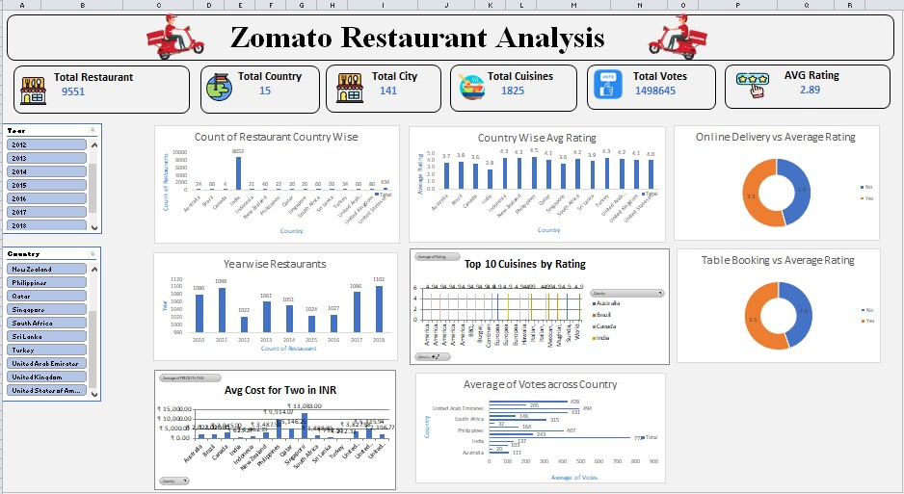
DASHBOARD

Slide 18
Features included in dashboard
This dashboard provides a comprehensive overview of Zomato restaurant analytics, capturing key metrics across various dimensions. Here’s a breakdown of the dashboard elements:
Total Restaurants, Countries, Cities, Cuisines: Displays a high-level summary of the Zomato dataset, showing the total number of restaurants (9,551), countries (15), cities (141), and cuisines (1,826) represented in the data. This gives a quick snapshot of the scale of operations.
Total Votes and Average Rating: Summarizes user engagement through total votes (14,98,645) and provides an overall average rating (2.89). These metrics indicate customer interaction and satisfaction levels.
Month-wise Restaurants: A line chart shows the number of restaurants added each month. The trend helps in understanding the growth over time and identifying peak periods.
Country-wise Restaurants: A bar chart represents restaurants’ distribution across different countries, with the United Kingdom leading with 80 restaurants. This can inform market penetration and regional focus.
Table Booking and Online Delivery: Donut charts provide insights into customer behaviour. High percentages for online delivery (93.98%) and table booking (89.89%) highlight the importance of these services.
Rating vs. Restaurants: A bar chart mapping the number of restaurants against their ratings. This helps in identifying how many restaurants fall within specific rating brackets, useful for quality assessment.

Slide 19
Features included in dashboard
Popular Cuisines: A bar chart showcasing the popularity of different cuisines, with Turkey and Brazil being particularly notable. This insight can guide menu decisions and marketing strategies.
Yearwise Restaurants: A bar chart that tracks the number of restaurants opened each year, providing a historical perspective on business expansion.
Interpretation:
City/Region Heatmap: Identifies areas with high average ratings for potential expansion.
Rating Distribution: Bar charts and scatter plots categorize restaurants by ratings for quick assessments.
Time Series Analysis: Line charts illustrate yearly restaurant openings for market growth insights.
Interactivity
Filters and Slicers: The dashboard includes ﬁlters for selecting speciﬁc cities, years or rating ranges, making it easier to drill down into the data for more detailed analysis.
Example: Users can ﬁlter the dashboard to view only high-rated restaurants in a particular city, helping to focus on top-performing areas for strategic decision-making.

Slide 20
Thank You!

